Slide 1
Discovery Tool :
Build your digital skills workshop
Alison Ormesher and Jon Lightfoot
21st February 2023

Slide 2
Overview
What are digital skills?
Intro to the Discovery Tool
Complete the questionnaire
Use your report to set goals on your TDP action plan

Slide 3





What are digital skills?
Digital skills can help you:
Manage / interpret data more effectively (e.g., Excel; Google Analytics)
Create better infographics / charts (e.g., PPT; Use styles in Word)
Manage time / revision efficiently (e.g., MS Planner; Lists)
Collaborate more easily with peers (e.g., Teams; OneNote)
Be better prepared for the workplace
(56% of UK employers need staff with improved digital skills*)
*Source: The Open University (2020). The Open University Business Barometer

Slide 4
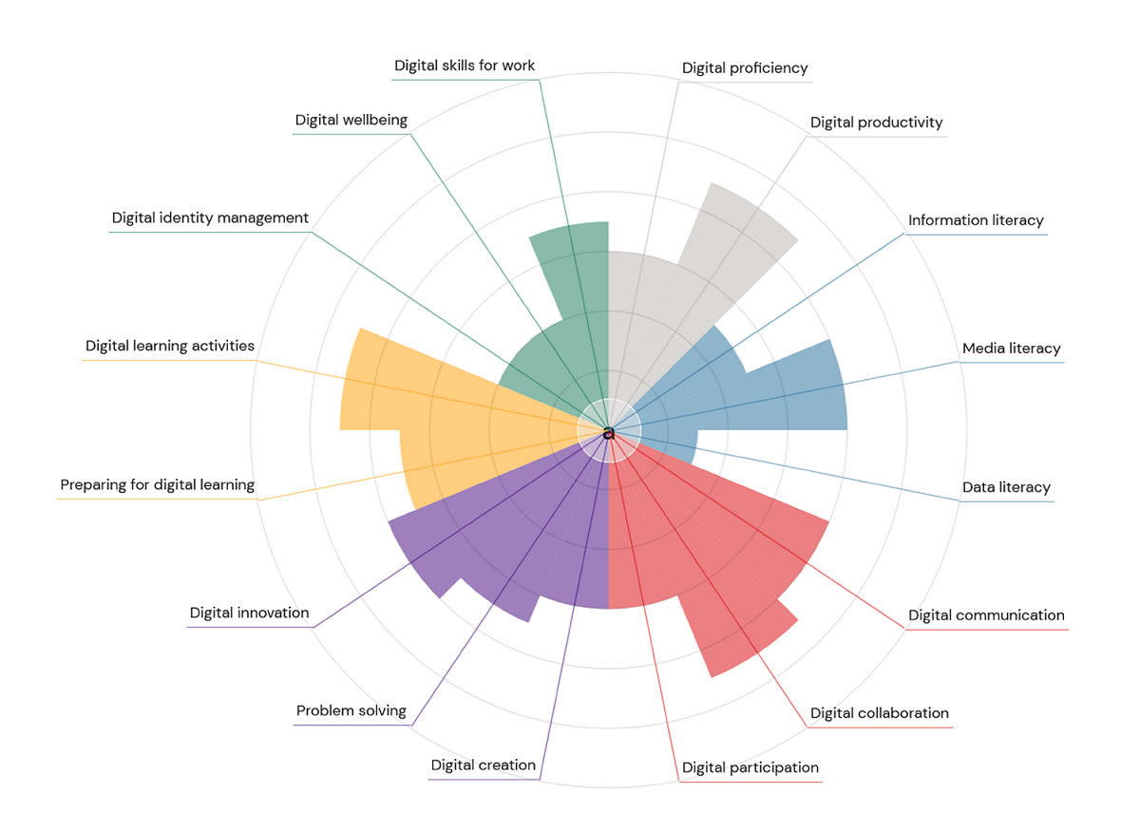




What is the Discovery Tool?
Jisc’s Digital skills self-assessment
+ Framework (anonymous)
Radar chart:
Confidence and skill level
Text summaries + advice
Developing
Capable
Proficient
Resource recommendations
Also DigiSkills Metro Map (LinkedIn Learning pathways)

Slide 5
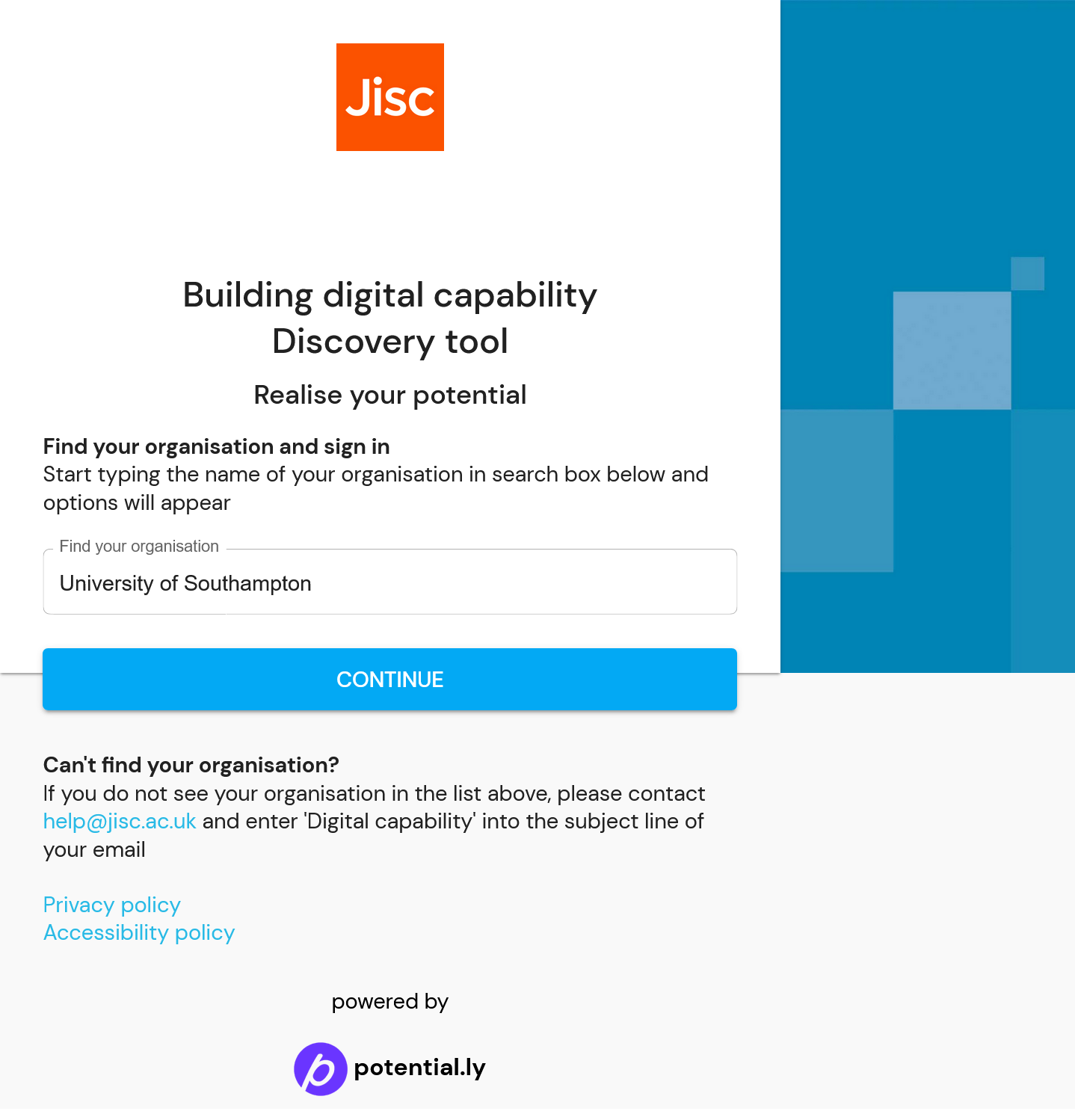
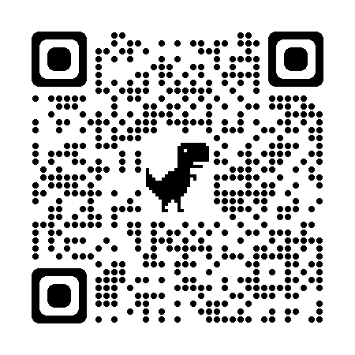
Discovery Tool Log in / QR code
To access the tool in the demo you will need to:
Access the internet on a laptop, tablet or smartphone
Log in as an HE student: https://jisc.potential.ly/signin
UG = HE (Bachelor’s or Honours)
PGT = HE (Master’s)
PhD = HE (Doctoral)
Notes:
https://jisc.potential.ly/signin

Slide 6
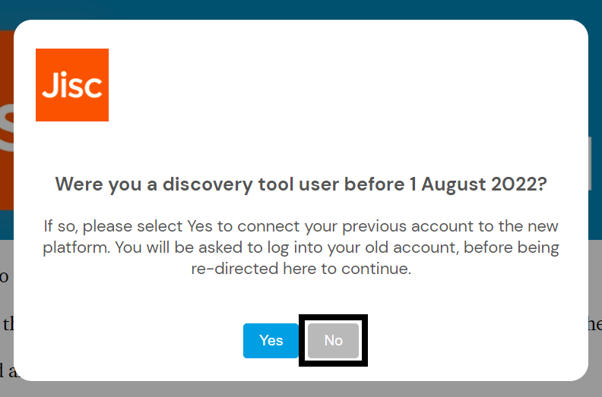
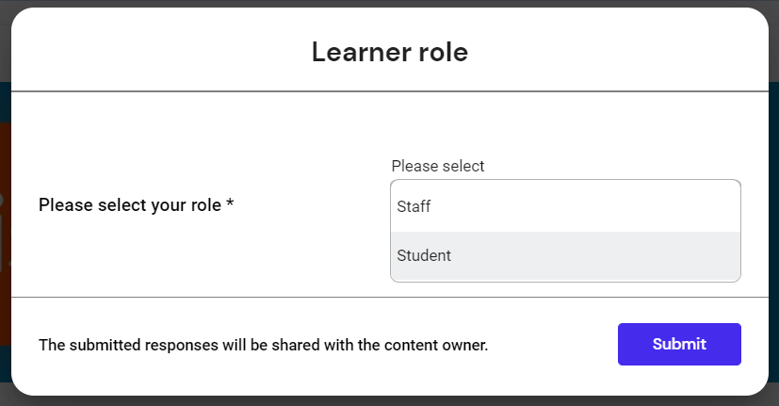
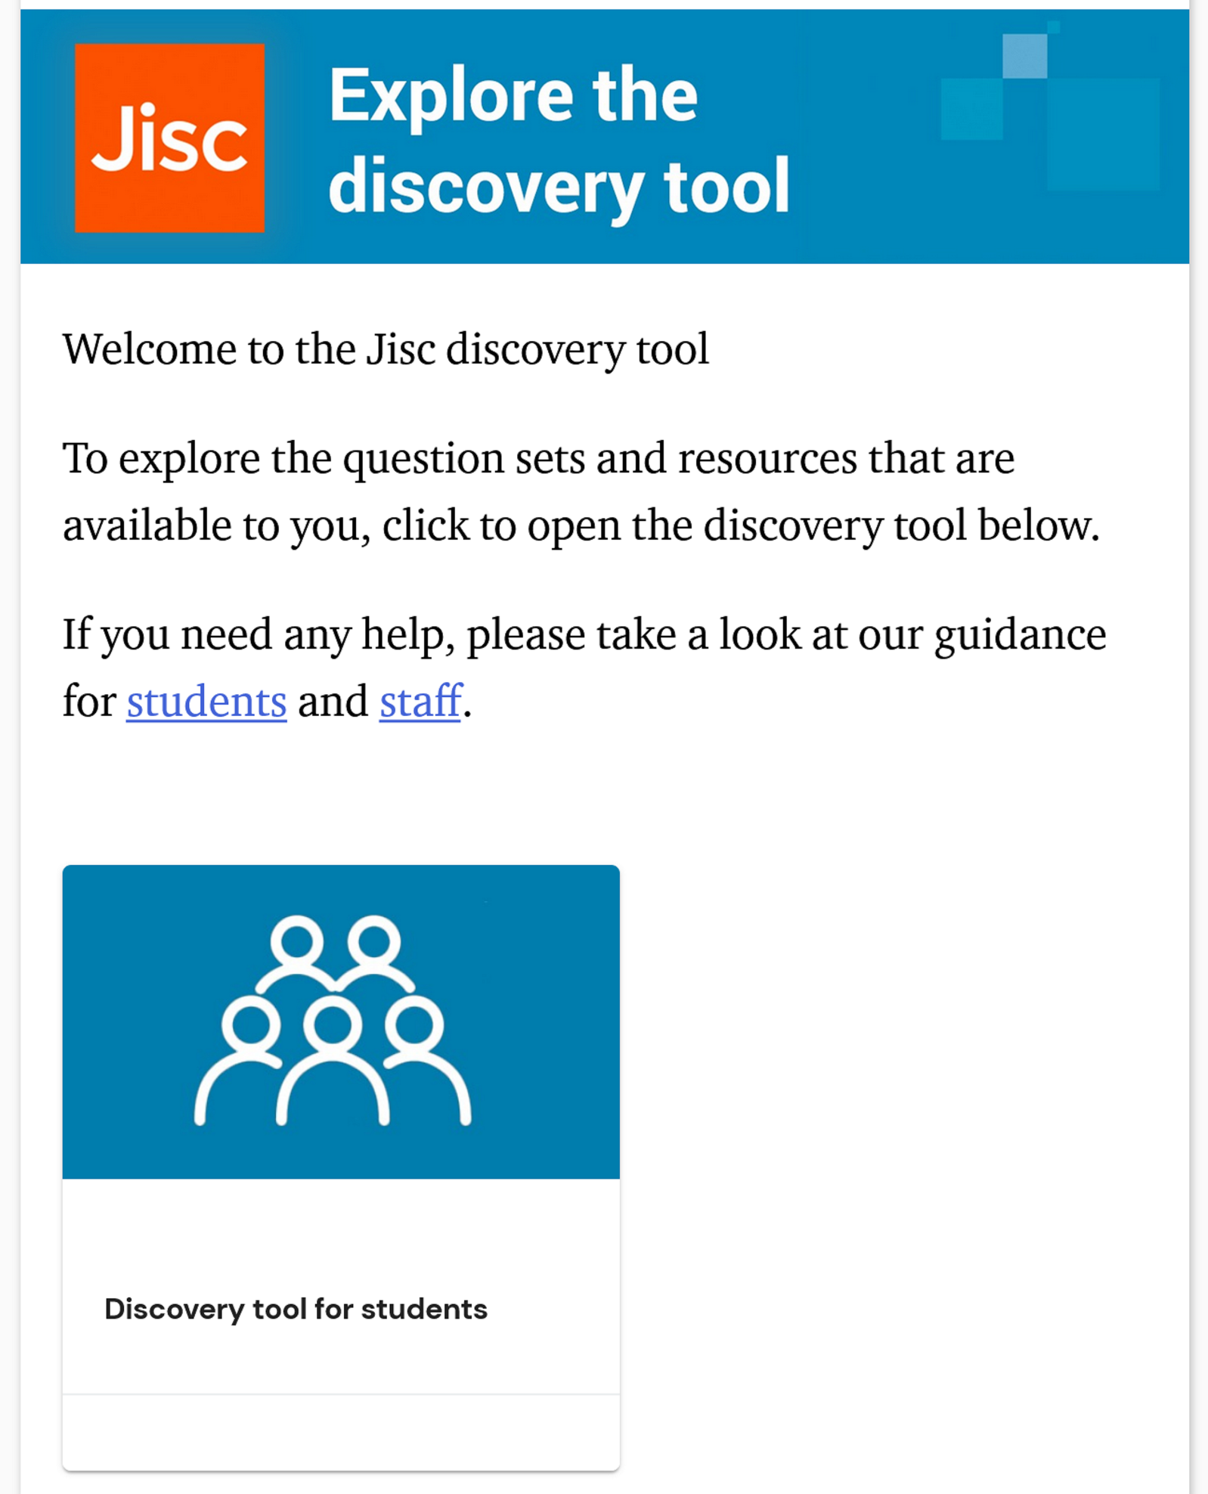
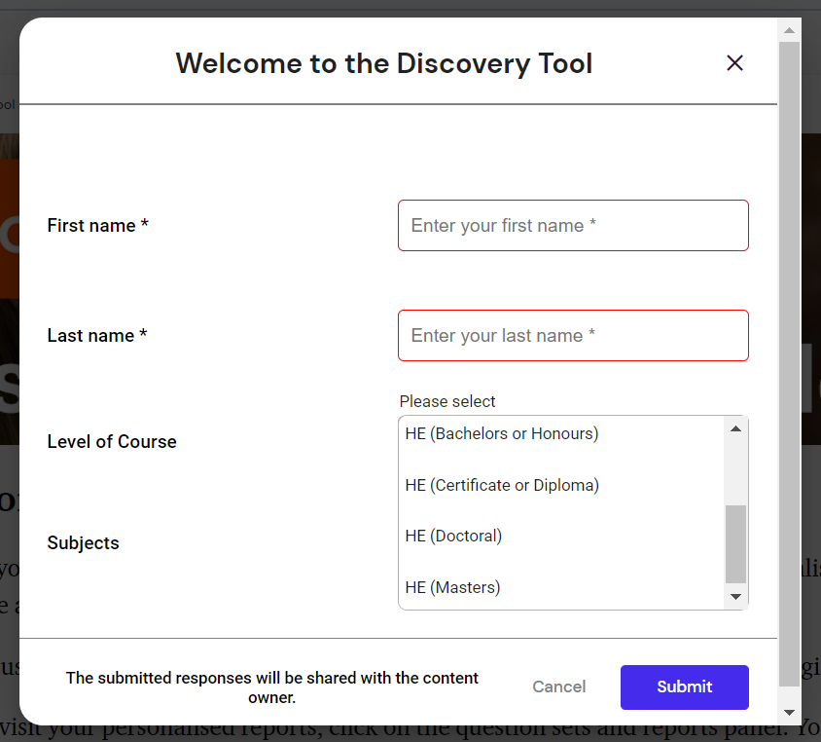
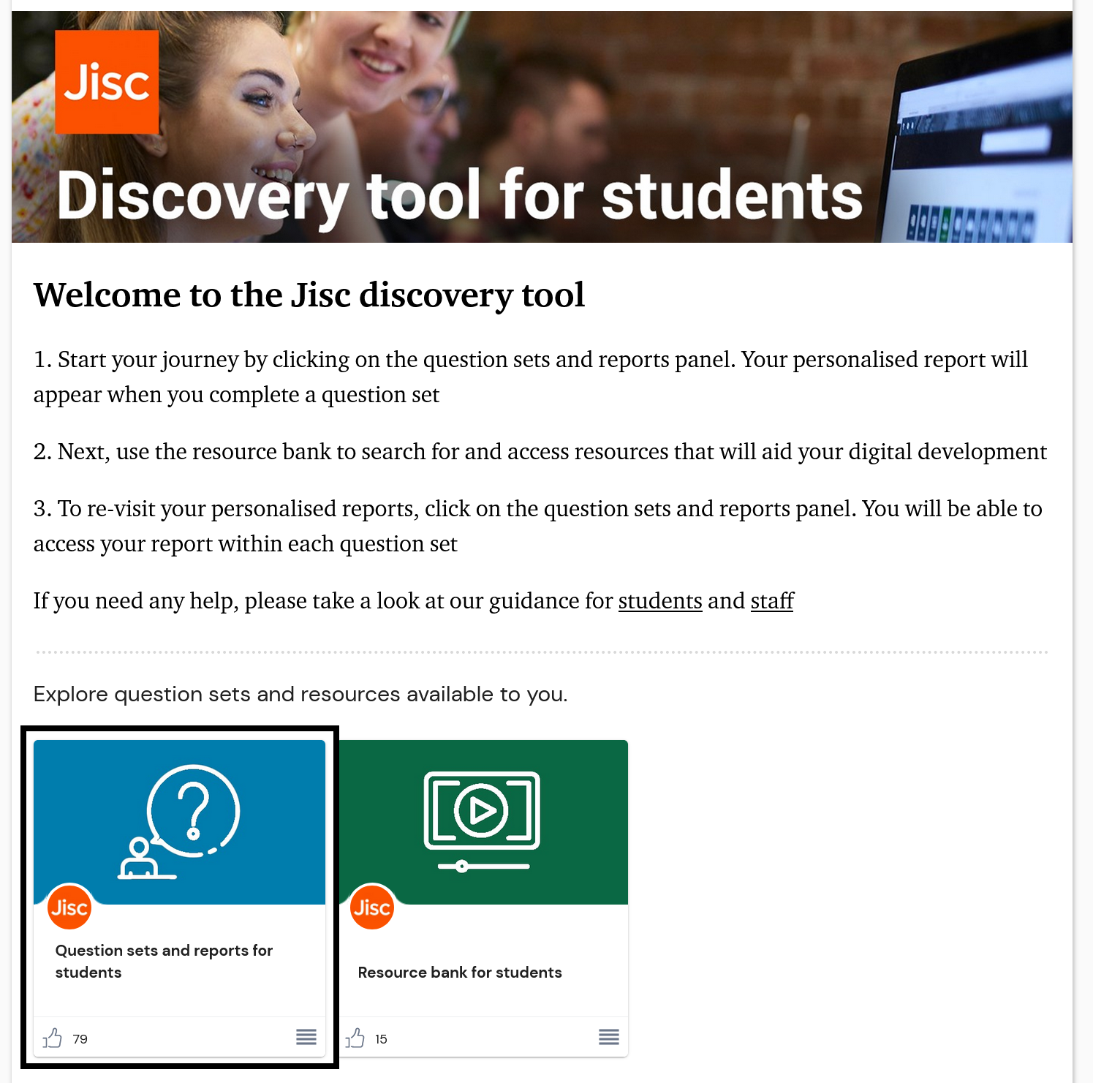
The first time you log in
Sign in with MFA and select ‘No’
Select ‘Student’ and submit
Open the blue tile ‘Discovery tool for students’
Add your name, ‘Level of Course’ and ‘Subjects’
UG = HE (Bachelor’s or Honours); PGT = HE (Master’s);
PhD = HE (Doctoral)
You’re in! Open ‘Question sets and reports for students’
Go to ‘Current students (Higher Education)’ question set

Slide 7
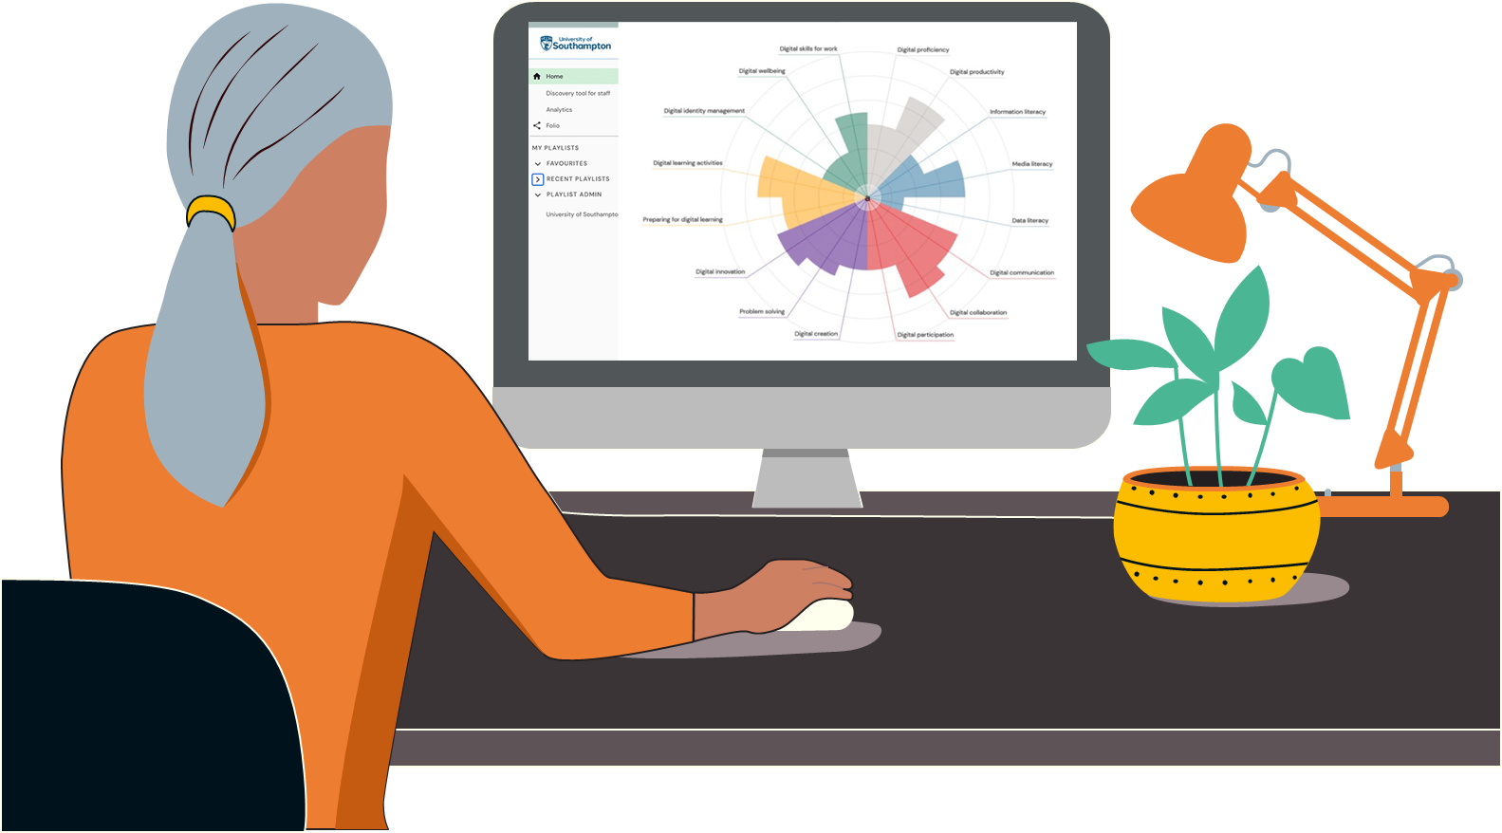
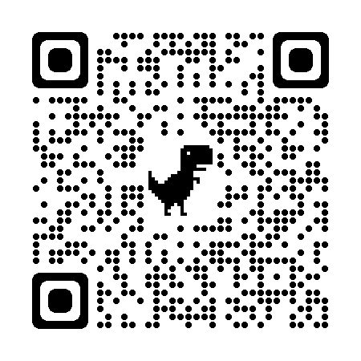
Try the Discovery Tool!
Log in and try the:
‘Current students (Higher Education)’ questionnaire
(15 minutes)
If you finish earlier:
View your report and your radar chart
Identify some skills gaps and areas to improve
Read the report and ‘Next steps’
Explore the ‘Resource Bank’
Download your report
If time, explore the DigiSkills Metro Map:
https://go.soton.ac.uk/metromap

Slide 8
Feedback Time!
Look at your radar chart and report. Are there any skills that you want to improve (and why)?
Think how these ideas fit into your TDP Action plan:
Where am I now?
Where do I want to be?
How am I going to get there? Use the
‘Resource Bank’, ‘Next Steps’ or DigiSkills Metro Map https://go.soton.ac.uk/metromap
Write some thoughts from Q1+2 into your action plan

Slide 9


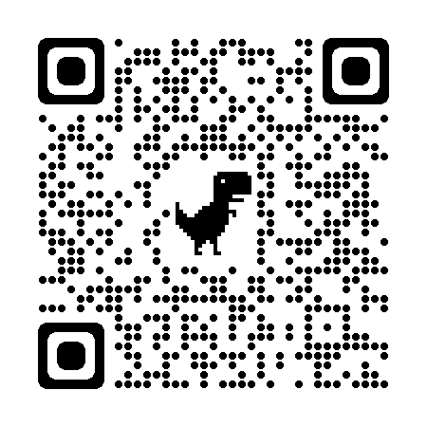


Next Steps
Add ideas on digital skills development to your TDP action plan
Find some resources via the DigiSkills Metro Map or
go to LiL at https://go.soton.ac.uk/lil and find your own
LiL login help page
Specialist Digital Skills for the School of Business
Retake the Discovery Tool questionnaire in 3 or 4 months

