Slide 1

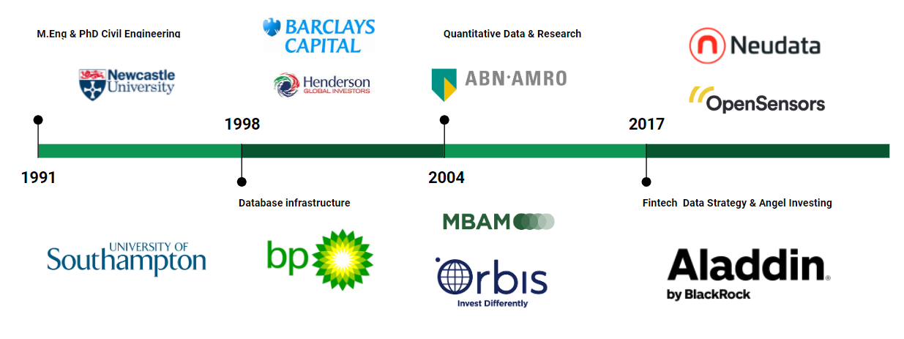


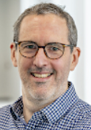

What they sold me……..
2022

Slide 2
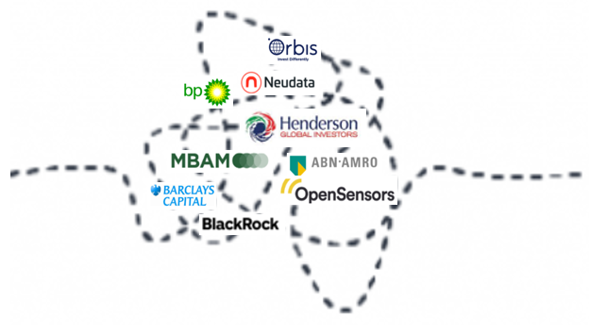

What I got……………

Slide 3

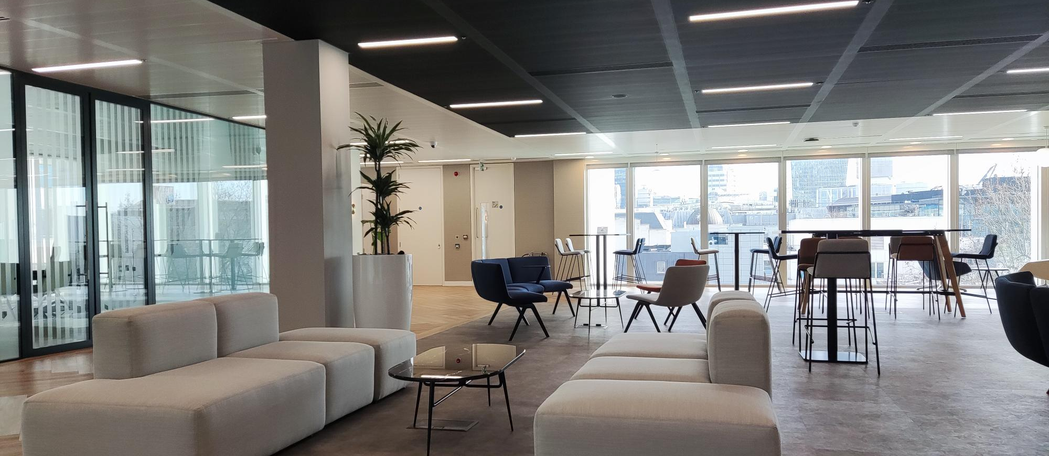
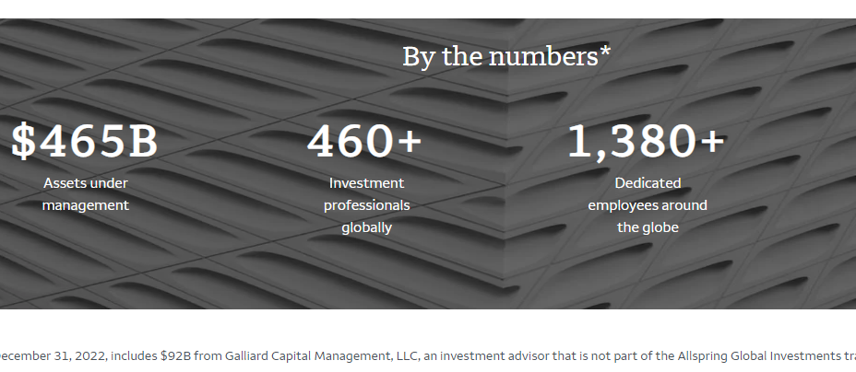


My Objective: To Fuel your
#ambition
#curiousity
#credibility
#authenticity
demonstrable
interest

Slide 4

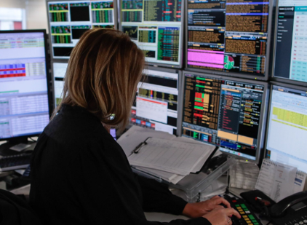



Buy Side or Sell Side
THE SELL SIDE
THE BUY SIDE
services
thinking beyond ‘trader’

Slide 5
Bake Off #1 – Services and Culture
THE SELL SIDE
THE BUY SIDE
services
Financial Service
Culture
Primary Markets
Rainmakers and Team Work
Secondary Markets

Slide 6
Bake Off #1 – Services and Culture
THE SELL SIDE
THE BUY SIDE
services
Financial Service
Culture
Investing
More of a Team Game

Slide 7

THOUGHTS FOR INTERVIEWING
What are your super powers?
        #thinking-fast
        # OR
        #thinking-slow

Slide 8

Bake Off #2 – Primary vs Secondary Markets
THE SELL SIDE
THE BUY SIDE
services
Primary Capital Markets
AKA Investment Banking

Slide 9
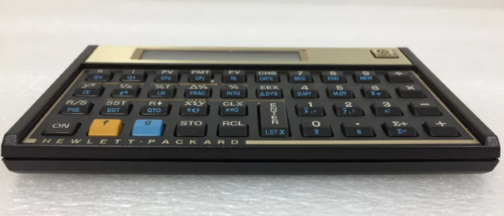
THOUGHTS FOR INTERVIEWING
What skills are needed for primary markets?
#corporate-finance
#accounting
#financial-creativity
#resilience

Slide 10
Bake Off #2 – Primary vs Secondary Markets
THE SELL SIDE
THE BUY SIDE
services
Secondary Markets
AKA Trading/Markets
+ Prime Brokerage (Hedge Funds)

Slide 11
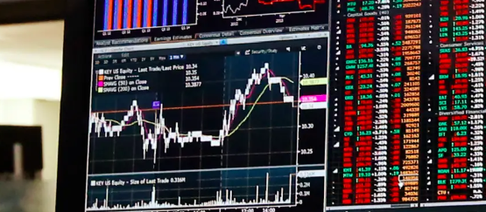
THOUGHTS FOR INTERVIEWING
What skills are needed for secondary markets?
#data-science
#econometrics
#process-and-scale

Slide 12
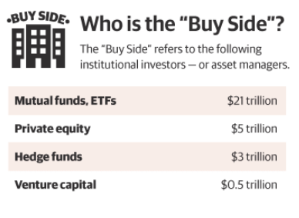

The Employment Bake Off
THE SELL SIDE
THE BUY SIDE
services
Passive Fund Management
ETFs

Slide 13
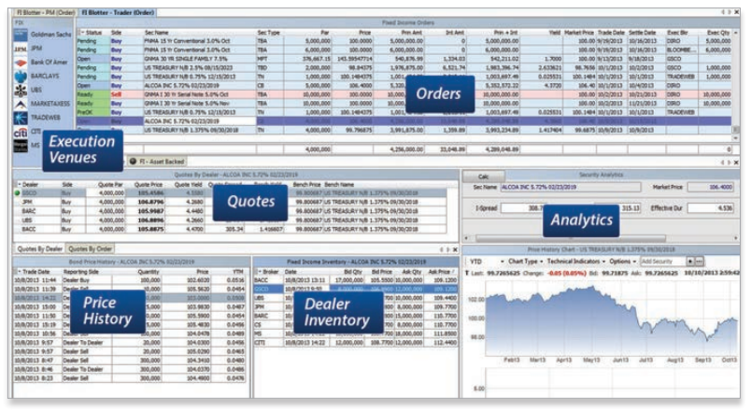
THOUGHTS FOR INTERVIEWING
What skills are needed for passive investing?
#portfolio-engineering
#econometrics
#process-and-scale

Slide 14
The Employment Bake Off
THE SELL SIDE
THE BUY SIDE
services
Active Fund Management
Mutual Funds
Quant Investing

Slide 15
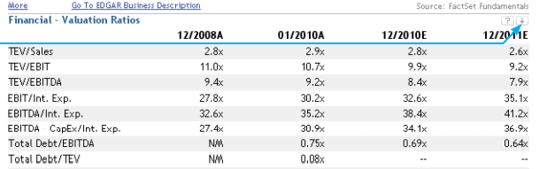
THOUGHTS FOR INTERVIEWING
What skills are needed for active investing?
#valuations
#data-science
#sustainability
#critical-thinking

Slide 16

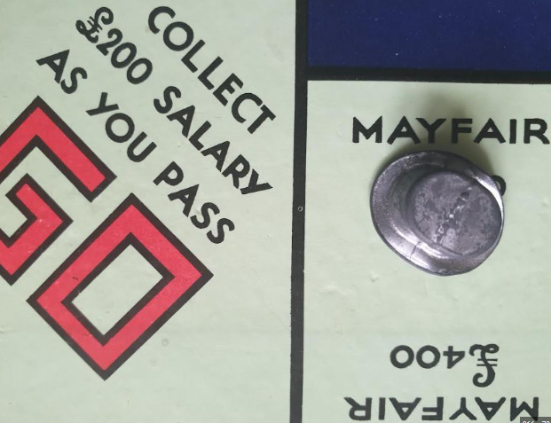
The Employment Bake Off
THE SELL SIDE
THE BUY SIDE
services
Alternatives
Hedge Funds
Private Equity
Real Assets
Venture Capital

Slide 17
THOUGHTS FOR INTERVIEWING
What skills are needed for alternatives?
VC >> #product-empathy
PE >> #accounting
Hedge Funds >> #data-science
fewer roles

Slide 18
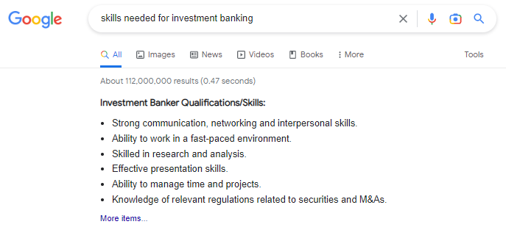
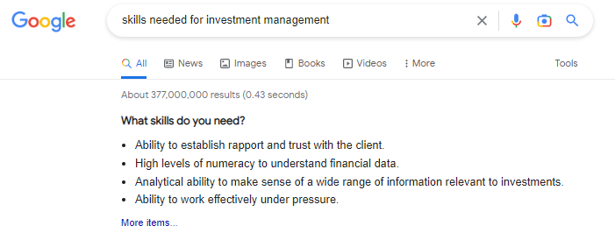
*TLDR: Too Long, Didn’t Read
TLDR* Sell Side
Communicating
Networking
Understanding Complexity
Fast Paced
TLDR* Buy Side
Trust
Numeracy
Processing Information
Work Under Pressure

Slide 19
#Energy
#Commitment
#Organisation
#Demonstrable Interest
ty!
Q&A

